Slide 1


Slide 2
Team Management and Managerial Decision-Making
DAY-(1)

Slide 3
CONCEPT-Part(1)
Why Teams? Why not individuals?
Cross-Functional Teams
Self-managing Teams
Departmental Teams
What is Management?
Significance/Importance

Slide 4
CHOOSE THE CORRECT OPTION
Think again about the activity of planning a family vacation. Imagine you’ve just arrived at the airport, and you check the departures schedule only to find that your flight is delayed by 3 hours. You realize this will cause you to miss your connecting flight and eventually arrive at your destination well after midnight, so you decide to call the airline’s customer service number to see if they can get you on a different flight. Which management activity are you primarily engaging in?
Analyzing and adapting to environment
Applying and distributing organizational resources effectively
Developing relationships with people to execute the plan

Slide 5
CONCEPT-Part(2)
What is Decision-Making?
--Defining the problem
-Gathering information and collecting data
-Developing and weighing the options
-Choosing best possible option
-Plan and execute
-Take follow up action
Why do we need to master it?

Slide 6
OBJECTIVE
Why are we learning?
Importance of Team-Building

Slide 7


Slide 8
METHODS
Methods to Make Teamwork Happen
Methods to Create Effective Team

Slide 9
Who participates and who does not?
• How do people take turns and who talks to whom and who responds to whom, etc.?
• How are interruptions handled? Is silence O.K.? Is anyone dominating the conversation?
• How are decisions made? Are they by consensus? Or are they by voting? Or by one person? While doing all this, one should be sure to observe one’s own feelings, reactions, and behaviours.

Slide 10
Team role | Description
Co-ordinator (Chairman) (CO) | Sets the team goals and defines roles and structures. Coordinates team efforts and leads by eliciting respect, but may not get involved in the task
Shaper (SH) | The task leader who brings competitive drive and energy to the team. Makes things happen but may be thought abrasive
Plant (PL) | Imaginative, creative and the team’s source of original ideas. Concerned with fundamentals. May not be ‘involved’ with the team
Monitor-Evaluator (ME) | Offers measured, dispassionate critical analysis. Keeps team from pursuing misguided objectives. Can be seen as negative
Resource Investigator (RI) | Salesman, diplomat, resource seeker. Good improviser with many external contacts. May be easily diverted from the task at hand
Completer (Finisher) (CF) | Worries about problems. Personally checks details. Intolerant of the casual and slapdash. Se
Teamworker (TW) | Promotes team harmony. Good listener who builds on the ideas of others. Likeable and non assertive. In avoiding conflict may lose focus on the task
Implementer/Company Worker (IM) | Turns decisions and strategies into manageable tasks. Brings logical, methodical pursuit of objectives to the team

Slide 11
BREAK-DOWN STRUCTURE
Setting Ground Rules
Team-Mission Statement
Steps for Effective Training Approach
Techniques of Training Team
Org Culture, Structure and Management
Modern Concept
Effectiveness Framework

Slide 12
TEAM-MANAGEMENT
Positive Reasons
Potential disadvantages
Analysis paralysis
Need for ultimate consensus
Watered down solutions
Lack of Productivity

Slide 13
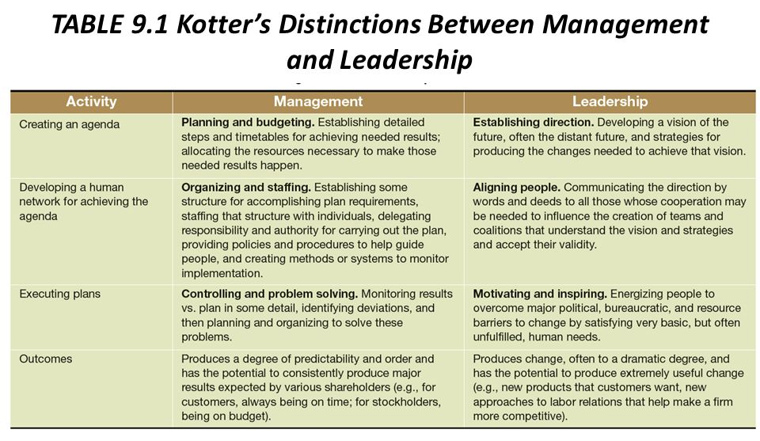
Kottler’s distinction between MANAGERS and LEADERS

Slide 14
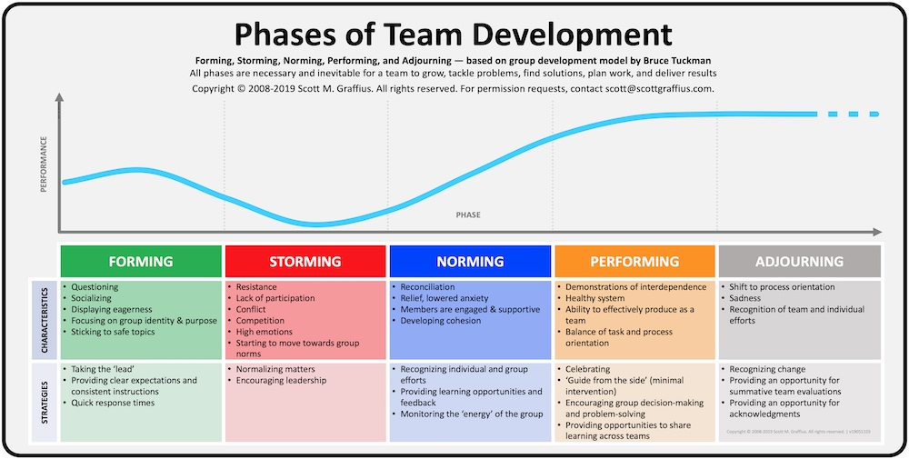
TEAM DEVELOPMENT MODEL

Slide 15
BARRIERS
Poor Communication
Unclear Goals Distorts Job Duties
Lack of Managerial Involvement
When Egos Get in the Way
Silo Thinking
Not Delegating Control

Slide 16
GROUP INTERCOMMUNICATION FORMULA
The group intercommunication formula measures the number of channels of communication within the project team, and can be expressed as n*(n-1)/2, where n is the number of people working on a project.

Slide 17
STEPHEN COVEY’s 7 HABITS
Be Proactive
Begin with the End in Mind
Put First Things First ( REFER THE NEXT SLIDE)
Think Win-Win
Seek First to Understand, Then to Be Understood
Synergize
Sharpen the Saw

Slide 18
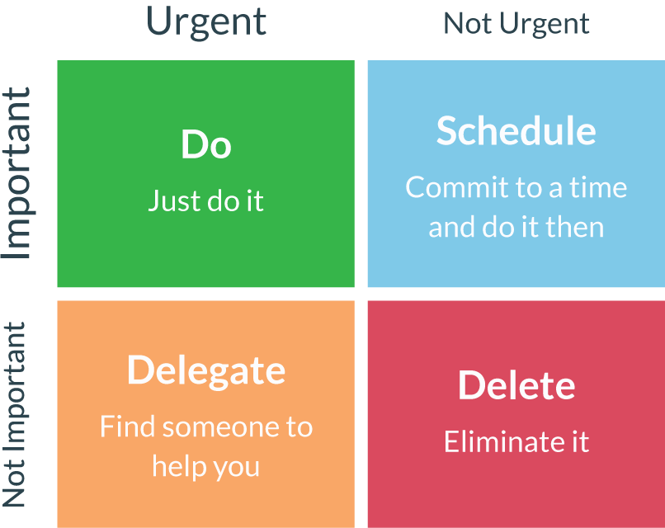
The Eisenhower Decision Matrix

Slide 19
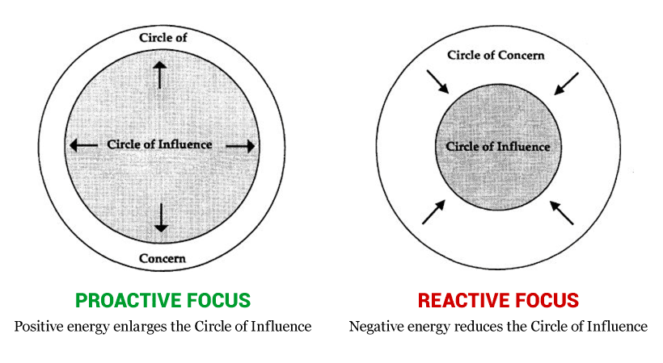
CIRCLE OF INFLUENCE + CIRCLE OF CONCERN

Slide 20
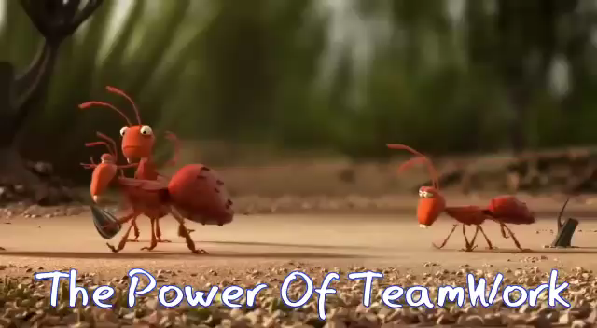
VIDEO

Slide 21


Slide 22


Slide 23


